Slide 1
Categorical predictors and nonlinear models
Gemma Wallace & Neil Yetz
PSY 653 Module 9 Lab
Apr 8, 2020

Slide 2
Demo Overview
We are practicing three different ways of examining categorical predictors in a regression framework:
Dummy coding
Effect coding
Orthogonal Polynomial Contrasts
Note: our outcome variables are continuous in each of these examples

Slide 3
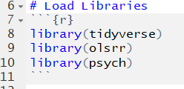
Load Libraries

Slide 4
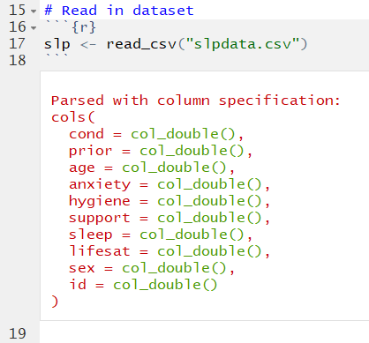
Read in Data
This is the same slpdata we’ve used in previous lab activities.
We’ll use these data for parts 1-2 of the demo, for dummy coding and effect coding

Slide 5
Our research question for parts 1-2:
To what extent do treatment condition, sex, and the interaction between these two variables predict sleep hygiene?
We will show two different ways to approach this question using different coding methods for the categorical predictor variables: dummy coding and effect coding
These two methods are similar, but the coding and interpretations are slightly different.

Slide 6
Part 1: Dummy coding

Slide 7
What is dummy coding and why use it?
One of the most common and simplest approaches to evaluating categorical predictors in psychology
Dummy coding allows you to compare the mean difference between two levels of a categorical variable: the level that is coded as a 1 versus the level that is coded as 0
You can specify any level of the variable to be the reference group (i.e., the level coded as 0)
Create a new “dummy coded” binary variable for every comparison you want to make between two groups
You only need to use dummy coding if you have more than two levels of a categorical predictor

Slide 8
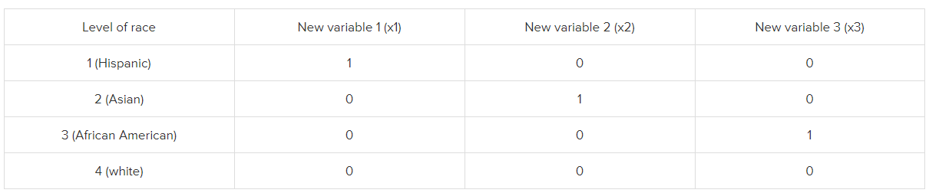
Dummy coding
For dummy coding, we will be converting categorical variables into a series of binary variables.
For all but one of the levels of the categorical variable, a new variable will be created that has a value of 1 for each observation at that level and 0 for all others.
Reference category
https://stats.idre.ucla.edu/spss/faq/coding-systems-for-categorical-variables-in-regression-analysis/

Slide 9
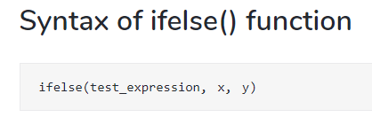
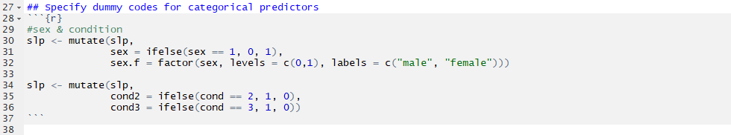
Specify dummy codes
TRUE
FALSE
We created two new variables:
cond2 is a dummy coded binary variable in which condition 2 is coded as 1 and condition 1 is coded as 0. This variable allows us to compare the mean difference in Y between conditions 2 and 1.
cond3 is a is a dummy coded binary variable in which condition 3 is coded as 1 and condition 1 is coded as 0. This variable allows us to compare the mean difference in Y between conditions 3 and 1.

Slide 10

Run model with dummy coded condition variable
Note: We aren’t including sex and the interaction term in this first model to make the initial interpretation simpler.

Slide 11
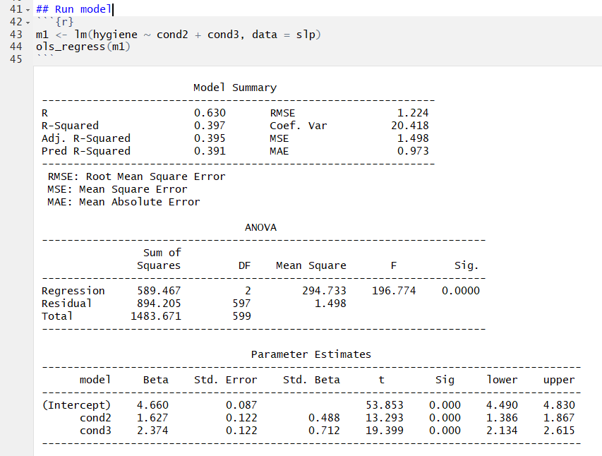
Interpretations
Intercept: The predicted sleep hygiene score when all x variables are zero, so participants in Condition 1.
cond2: the predicted difference in sleep hygiene score between participants in condition 2 compared to condition 1.
cond3: the predicted difference in sleep hygiene score between participants in condition 3 compared to condition 1.

Slide 12
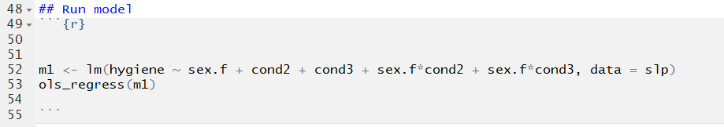
Run model with dummy coded condition, sex & interaction

Slide 13
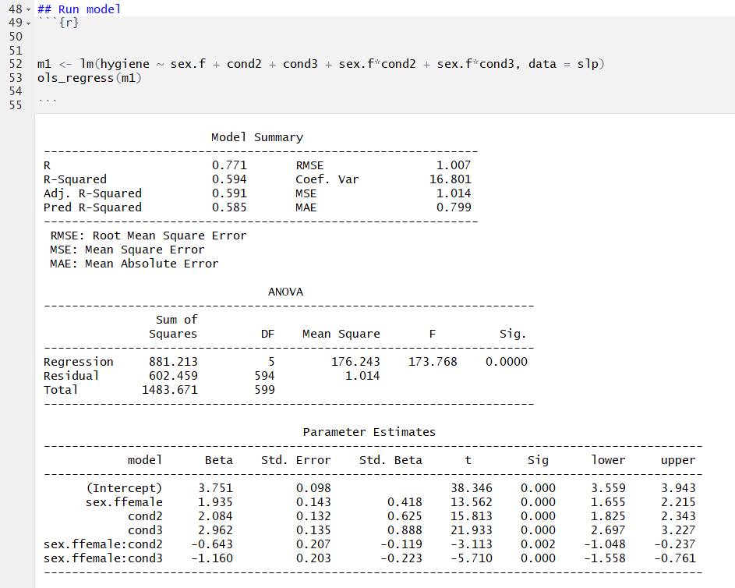
Interpretations
Intercept: The predicted sleep hygiene score when all x variables are zero, so males in Condition 1.
female: This variable is involved in an interaction, so it's a simple slope. Specifically, it is the effect of female when both cond2 = 0 and cond3 = 0, so people in Condition 1. Therefore, it is the predicted difference in sleep hygiene between females and males in Condition 1. The slope is positive, meaning that females in Condition 1 tend to have better sleep hygiene than males in Condition 1. This is a statistically significant difference (p-value is less than alpha).
cond2: This variable is involved in an interaction, so it is a simple slope. It is the effect of being in Condition 2 (compared to Condition 1) when female = 0, so among males. It is the predicted difference in sleep hygiene for males in Condition 2 compared to males in Condition 1. This is a statistically significant difference (p-value is less than alpha).
cond3: This variable is involved in an interaction, so it is a simple slope. It is the effect of being in Condition 3 (compared to Condition 1) when female = 0, so among males. It is the predicted difference in sleep hygiene for males in Condition 3 compared to males in Condition 1. This is a statistically significant difference (p-value is less than alpha).
female:cond2: The predicted differential effect of being in Condition 2 compared to Condition 1 for females compared to males. This is a statistically significant difference (p-value is less than alpha). The coefficient for cond2 presents the effect (i.e., benefit) of being in Condition 2 (compared to 1) for males. To get the effect for females, we take the effect for males (2.084) and add the female:cond2 interaction term (-.643). Therefore, the effect (i.e., benefit) of being in Condition 2 (compared to Condition 1) for females is 1.441.
female:cond3: The predicted differential effect of being in Condition 3 compared to Condition 1 for females compared to males. This is a statistically significant difference (p-value is less than alpha). The coefficient for cond3 presents the effect (i.e., benefit) of being in Condition 3 (compared to 1) for males. To get the effect for females, we take the effect for males (2.962) and add the female:cond3 interaction term (-1.160). Therefore, the effect (i.e., benefit) of being in Condition 3 (compared to Condition 1) for females is 1.802.

Slide 14
Part 2: Effect Coding

Slide 15
What is effect coding and why use it?
Similar to dummy coding, except here, you are comparing one level of a categorical predictor to the mean of all of the levels.
Instead of asking “are two conditions different from each other?” using dummy coding, effect coding asks “is this condition different from average?”
While the "rule" in dummy coding is that only values of 0 and 1 are valid, the "rule" in effect coding is that all of the values in any new variable must sum to zero.
Notes:
If you have several categorical variables in a model it often doesn’t make much difference whether you use effect coding or dummy coding.

Slide 16
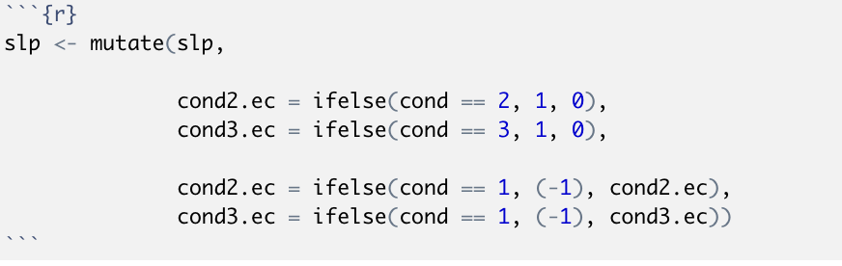
Specify effect coding variables
We created two new variables:
cond2.ec is a effect coded variable in which condition 2 is coded as 1, condition 1 is coded as -1, and condition 3 is coded as 0. This variable allows us to compare the mean difference in Y between condition 2 and the average score across all conditions.
cond3.ec is a is a dummy coded binary variable in which condition 3 is coded as 1, condition 1 is coded as -1, and condition 2 is coded as 0. This variable allows us to compare the mean difference in Y between condition 3 and the average score across all conditions.
Notes:
Renamed variables to avoid potential issues overwriting variables from dummy coding part

Slide 17
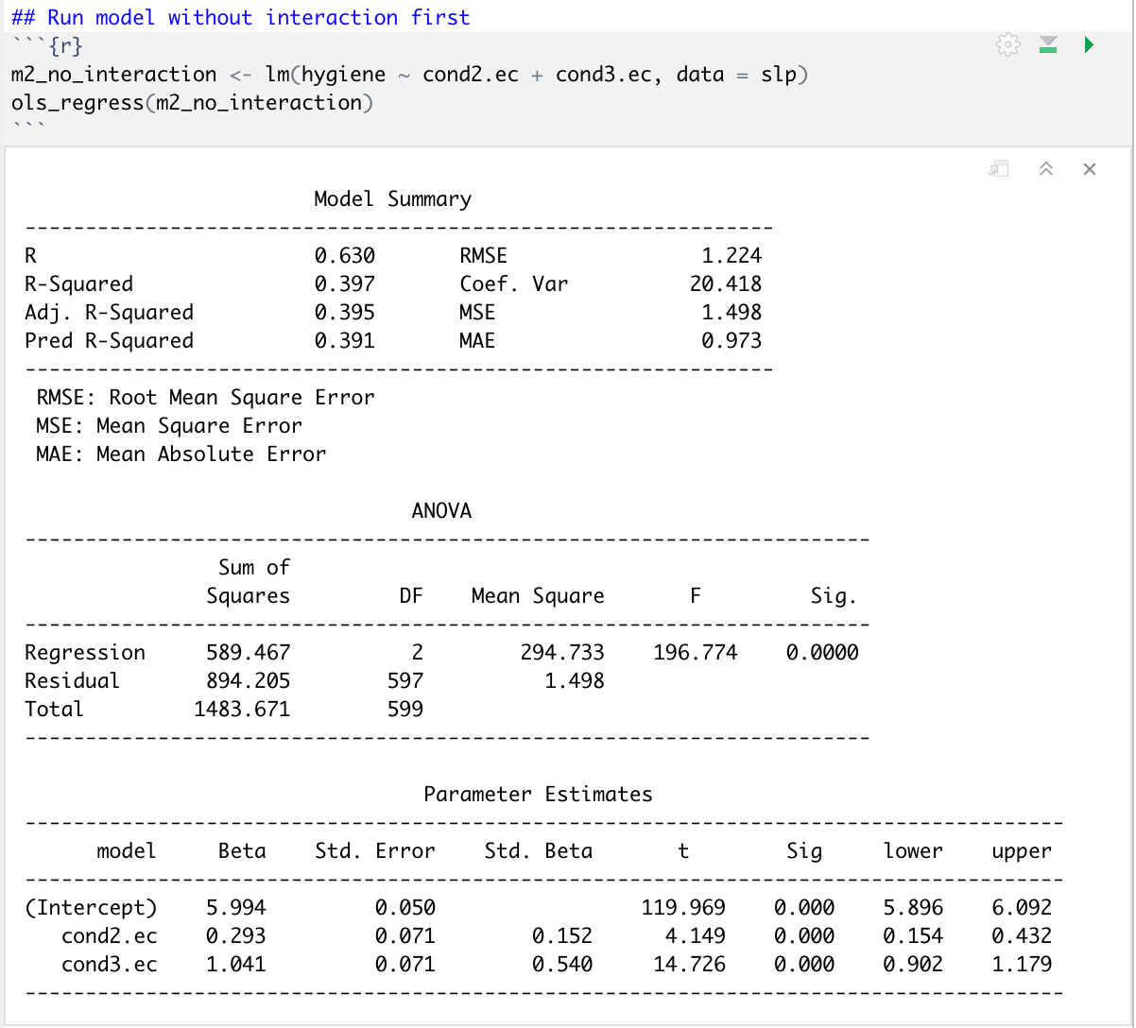
Interpretations
Intercept: In effect coding, the intercept is the grand mean of sleep hygiene across all the three treatment groups
cond2: the predicted difference in sleep hygiene score between participants in condition 2 compared to the mean of all three treatment conditions.
cond3: the predicted difference in sleep hygiene score between participants in condition 3 compared to the mean of all three treatment conditions.
Note: We aren’t including sex and the interaction term in this first model to make the initial interpretation simpler.

Slide 18
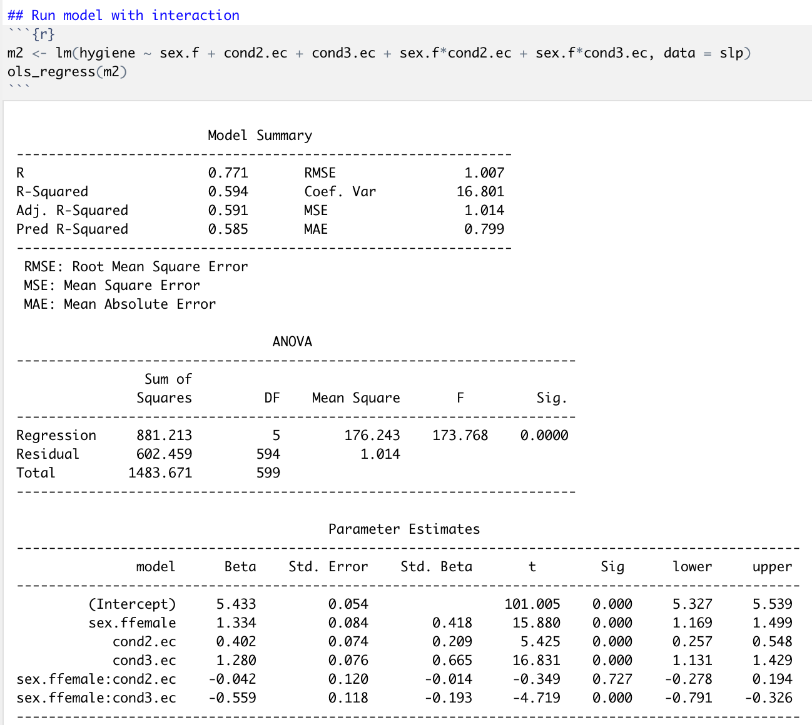
Interpretations
Intercept: The intercept is the grand mean of sleep hygiene among males (i.e., when x = 0) across all of the conditions..
sex.ffemale: This variable is involved in an interaction, so it's a simple slope. It is the predicted difference in average sleep hygiene between females and males across all of the conditions
cond2: This variable is involved in an interaction, so it is a simple slope. It is the effect of being in Condition 2 (compared to the average of all three conditions) when female = 0, so among males. It is the predicted difference in sleep hygiene for males in Condition 2 compared to the grand mean of sleep hygiene (the mean of condition 2 is 0.402 higher than the grand mean, 5.433). This is a statistically significant difference (p-value is less than alpha).
cond3: This variable is involved in an interaction, so it is a simple slope. It is the effect of being in Condition 3 (compared to the average of all three conditions) when female = 0, so among males. It is the predicted difference in sleep hygiene for males in Condition 3 compared to the grand mean of sleep hygiene (the mean of condition 3 is 1.280 higher than the grand mean, 5.433). This is a statistically significant difference (p-value is less than alpha).
female:cond2: female:cond2: The predicted differential effect of being in Condition 2 compared to the grand mean for females compared to males. This is not a statistically significant difference (p-value is greater than alpha). The coefficient for cond2 presents the effect (i.e., benefit) of being in Condition 2 (compared to average) for males. To get the effect for females, we take the effect for males (0.402) and add the female:cond2 interaction term (-.042). Therefore, the effect (i.e., benefit) of being in Condition 2 (compared to average for females is 0.36.
female:cond3: The predicted differential effect of being in Condition 3 compared to average for females compared to males. This is a statistically significant difference (p-value is less than alpha). The coefficient for cond3 presents the effect (i.e., benefit) of being in Condition 3 (compared to average) for males. To get the effect for females, we take the effect for males (1.280) and add the female:cond3 interaction term (-.559). Therefore, the effect (i.e., benefit) of being in Condition 3 (compared to average) for females is 0.721.
The model suggests that males benefit more from cond3 compared to average, compared to how much females benefit from cond3 compared to average.

Slide 19
Part 3: Orthogonal polynomials contrasts

Slide 20
What are orthogonal polynomial contrasts (aka trend contrasts) and why use them?
Allow us to evaluate non-linear relations between a categorical predictor and an outcome
With continuous predictors we can model these by squaring X to test a quadratic effect, cubing X to test a cubic effect, etc.
With categorical predictors, we can use specific polynomial contrasts to test different effects. These contrast levels can be found online, or in the table on slide 25!
This type of coding system should be used only with an ordinal variable in which the levels are equally spaced

Slide 21
Efffects we can evaluate with more than 3 levels of a categorical predictor:
Linear: If we increase the dose level the Y values will increase, and we can select the best level based on the highest dose. Y = a + bX
Quadratic: If we increase the dose level the Y values will be increased until certain dose after that the level of dosage will have a negative effect. Y = a + b₁X + b₂X²
Cubic: The dosage would increase Y values after certain dosage and then decrease and if we increase more the dosage level, the Y values will increase. Y = a + b₁X + b₂X² + b₃X³
Notes:
Stack exchange
https://www.researchgate.net/post/Linear_quadratic_and_cubic_polynomial_contrasts

Slide 22
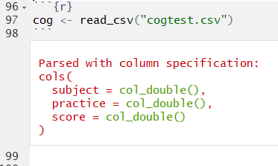
New dataset description
Researchers were interested in the effect of time spent in practice on the performance of a visual discrimination task. Subjects were randomly assigned to different levels of practice, following which a test of visual discrimination is administered, and the number of correct responses is recorded for each subject. 40 subjects were randomly assigned to practice 0 minutes, 2 minutes, 4 minutes, 6 minutes, 8 minutes, 10 minutes, 12 minutes, or 14 minutes.
There are two variables:
practice = minutes spent practicing, this was assigned by the experimenter
score = the number of correct answers on the test

Slide 23
Filter practice to only 4 conditions
We selected four evenly spaced conditions to test non-linear effects between practice and score
We could include more than four levels of practice if we wanted to, but we use four levels in this example for a simpler interpretation

Slide 24
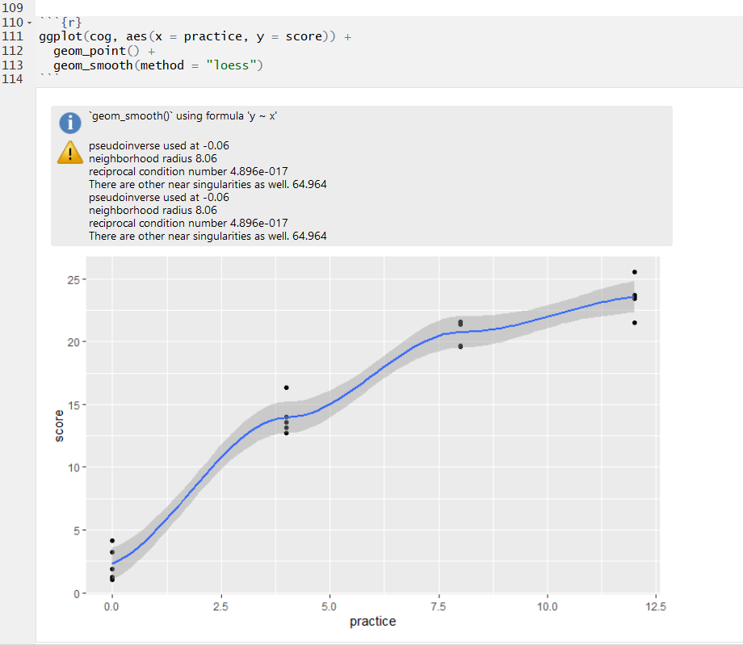
Visualize the relation between X and Y
The slope appears to become less steep as practice time increases. Since there may be a curve to the regression line, we should test for more than a linear effect. Since we have four levels of our categorical variable, we can test both a quadratic and cubic effect.

Slide 25
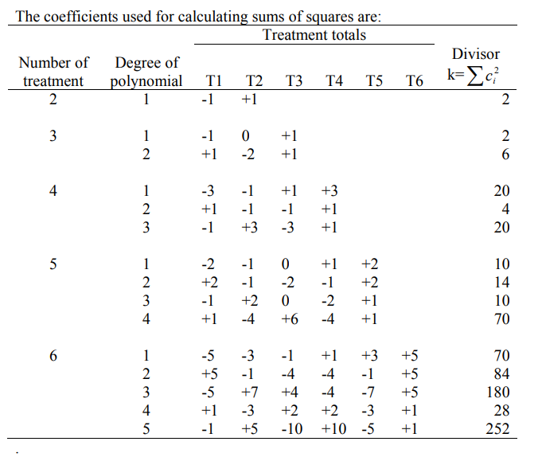
We have 4 treatment levels
https://www.ndsu.edu/faculty/horsley/Polycnst.pdf

Slide 26
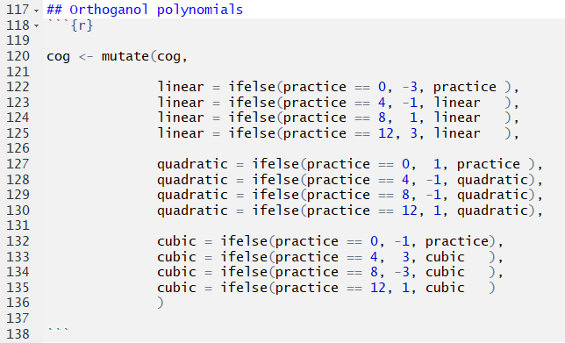
Specify the orthogonal polynomial contrasts
All of these contrasts come from the table on the previous slide!
We created three new variables:
linear specifies contrasts for testing a linear effect
quadratic specifies contrasts for testing a quadratic effect
cubic specifies contrasts for testing a cubic effect

Slide 27
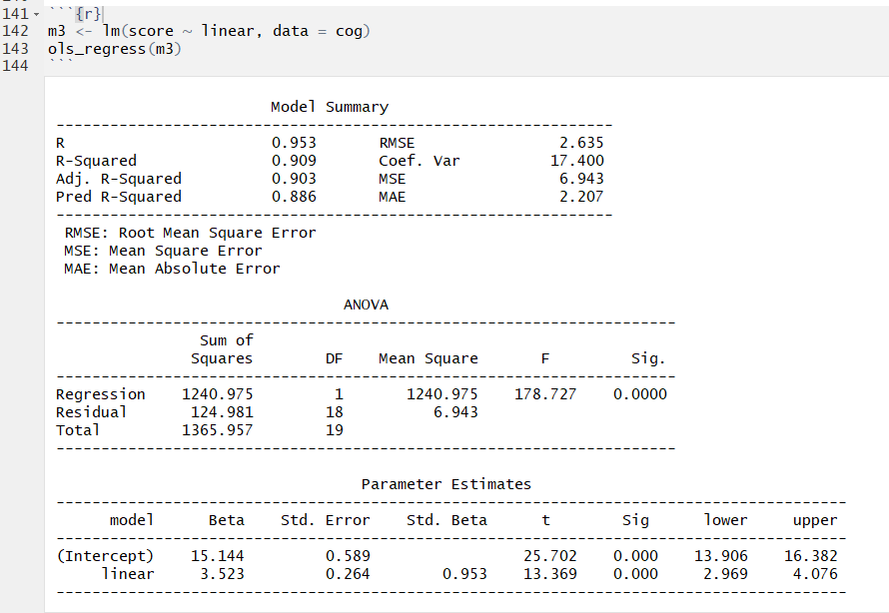
Step 1: Regress score on linear effect
The model testing the linear effect between practice and score explained 90.9% of the variance in score, and the linear trend was statistically significant at p<0.001.
This model fits the data pretty well, but since we observed a potential curved relationship when we plotted the data, there could be a better way to examine this relationship.
Evidence of linear effect

Slide 28
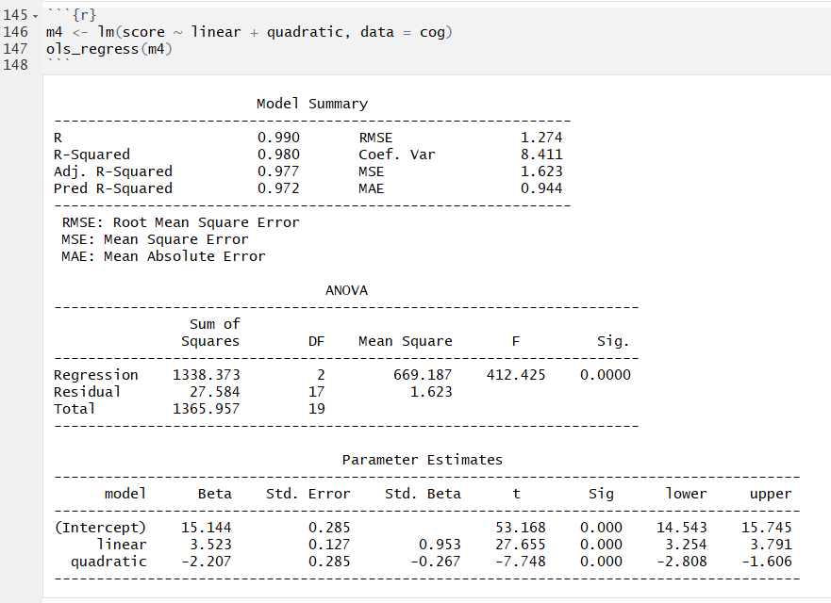
Step 2: Regress score on linear & quadratic effect
The model testing the linear and quadratic effects between practice and score explained 98.0% of the variance in score, which is 7.1% higher than the model that only tested the linear relation.
The quadratic term is statistically significant, indicating that there is a substantial curve to the relation between practice and score (i.e., it's not linear). We need to maintain the quadratic term in the model.
Evidence of quadratic effect

Slide 29
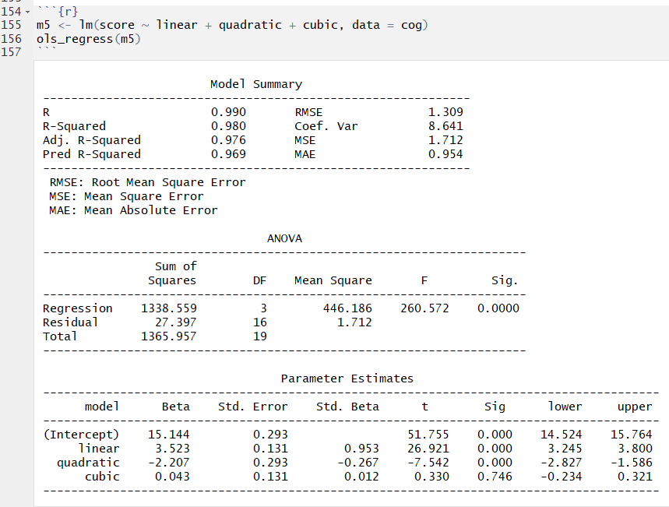
Step 3: Regress score on linear, quadratic & cubic effect
We tested the cubic term to determine if there is a second bend to the relationship between practice and score. Since we have at least four levels of our categorical predictor, we can test the cubic effect.
This model explains the same amount of variance in score as the previous model that only included the linear and quadratic effects (i.e., adding the cubic effect does not increase the explanatory power of the model).
The cubic term is not significant, indicating that there is not a second bend to the relationship. Therefore, the quadratic model is the best fit for these data.
No evidence of cubic effect

Slide 30
Additional resources on categorical variable coding systems:
https://stats.idre.ucla.edu/spss/faq/coding-systems-for-categorical-variables-in-regression-analysis/
http://www.jds-online.com/files/JDS-563.pdf
https://www.ndsu.edu/faculty/horsley/Polycnst.pdf
https://www.researchgate.net/post/Linear_quadratic_and_cubic_polynomial_contrasts

